Slide 1

Welcome to the FIRST EVER Joint Social Mixer
With the
Committees on Applied Statisticians,
Career Development, &
Member Retention and Recruitment
JSM
Hosted by the Members and the Chairs:
Erin Tanenbaum Tanenbaum-Erin@norc.org
Elizabeth Margosches don@melman.com Jennifer Gauvin jennifer.gauvin@novartis.com

Slide 2
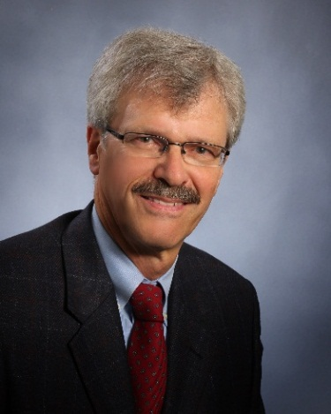
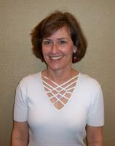
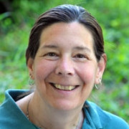
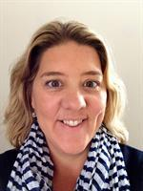
Committee Liaisons
Membership Council Liaisons: James L. Rosenberger and Holly B. Shulman
ASA Liaisons: Donna LaLonde and Amy Farris
Not pictured: Stephen Porzio, Rick Peterson

Slide 3
Meet the Committees
CAS Committee on Applied Statisticians
CCD Committee on Career Development
CMRR Committee on Member Retention and Recruitment

Slide 4

CAS
Committee on Applied Statisticians

Slide 5
Committee on Applied Statisticians Charge
Promote state of the art methods and technologies.
Facilitate recognition of applied statistics within various fields of application.
Coordinate with other ASA groups/units to ensure attention to the needs, priorities and career paths of applied statistics.
Increase awareness and promote careers in applied statistics.

Slide 6
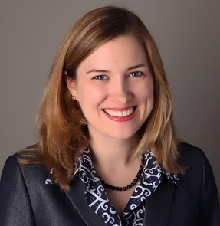
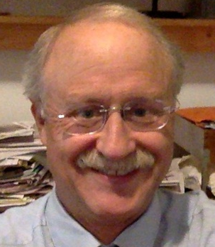
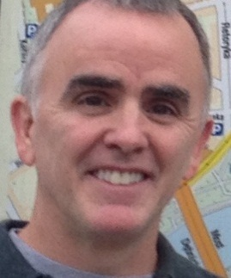
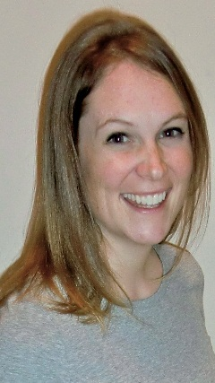
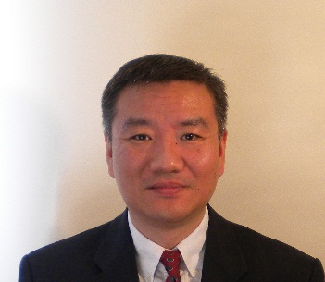
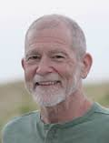
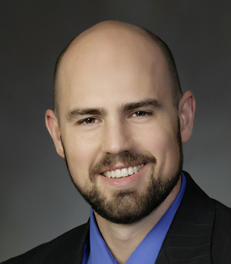
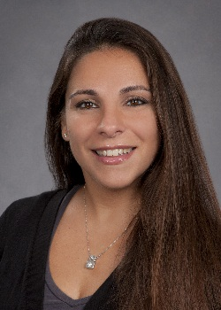
CAS Members Include
Erin R. Tanenbaum, MA
Senior Statistician
Statistics and Methodology
NORC at the University of Chicago
Committee Chair
Charles Kincaid
Experis
Emily Olsen
CDC
Mark Otto
Biometrician
U.S. Fish and Wildlife Service
Committee Vice-Chair
John Lin
Senior Vice President
Analytics
Epsilon
Eric Vance, PhD
Director, LISA
Associate Research Professor, Virginia Tech Department of Statistics
Shari Messinger Cayetano, Ph.D
Associate Professor of Biostatistics
Director, BCCC
Division of Biostatistics
Department of Public Health Science
University of Miami Miller School of Medicine
Richard Morris
Recently Retired from
SRA International

Slide 7
Special Project: Mentoring
Mentoring In a Bag – find your own mentor with this how-to-guide
Mentoring In a Box – organize a mentoring program with this how-to-guide
Mentoring Workshop, JSM 2015
Mentoring 2013 & 2014, dozens of mentors matched with mentees with formal direction

Slide 8
Ongoing Initiatives
Amstat News: Master’s Notebook
Coordinate invited and topic-contributed sessions (and roundtables) for CSP and JSM
Liaison with other committees and sections
Social mixer, Microsite with activities mentioned, friends of CAS email distribution list, historian documents previous efforts, and much more!

Slide 9

CCD
Committee on Career Development

Slide 10
Committee on Career Development Charge
Provide information to help members of the Association make informed decisions on formulating and meeting their career objectives.
Provide information to help persons outside of the Association make informed decisions about a possible career in statistics.

Slide 11
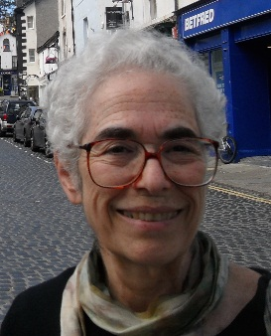
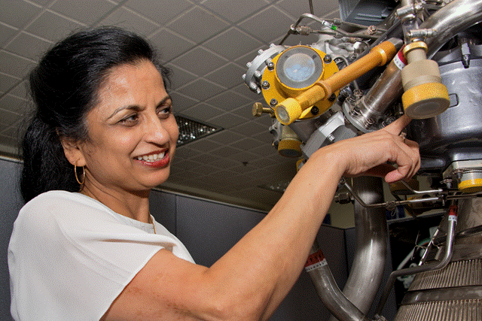
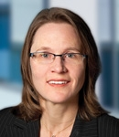
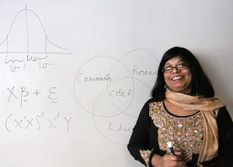
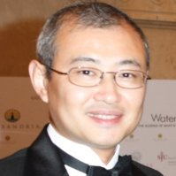
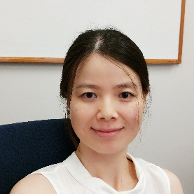
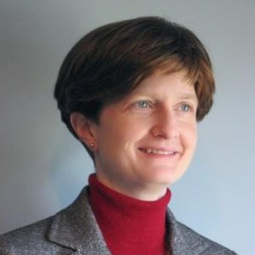
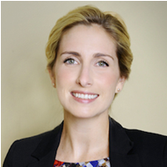
CCD Members Include
  Elizabeth H. Margosches (Chair), USEPA, retired
  Monica L. Johnston (Vice-Chair), M. Lee & Company
  Mandy Bergquist
  Joshua Chen, Sanofi Pasteur
  Daksha J. Chokshi, Aerojet Rocketdyne
  Nairanjana Dasgupta, Washington State University
  Dawn E. Eash, Berkeley Research Group
  Xiaomin Lu, University of Florida
  Susan Paddock, RAND Corporation

Slide 12
Ongoing CCD Initiatives
Conduct career satisfaction survey for ASA during 2015-2016 (with CMRR and COWIS).
Respond to requests for speakers on careers in statistics.
Explore opportunities to answer statistics career-related questions from K-12 and college students.
Explore career-related research questions and topics (e.g., career satisfaction, underemployment, unemployment, etc.).

Slide 13

CMRR
Committee on Membership Retention and Recruitment

Slide 14
CMRR Charge
To promote and preserve membership in the ASA.

Slide 15
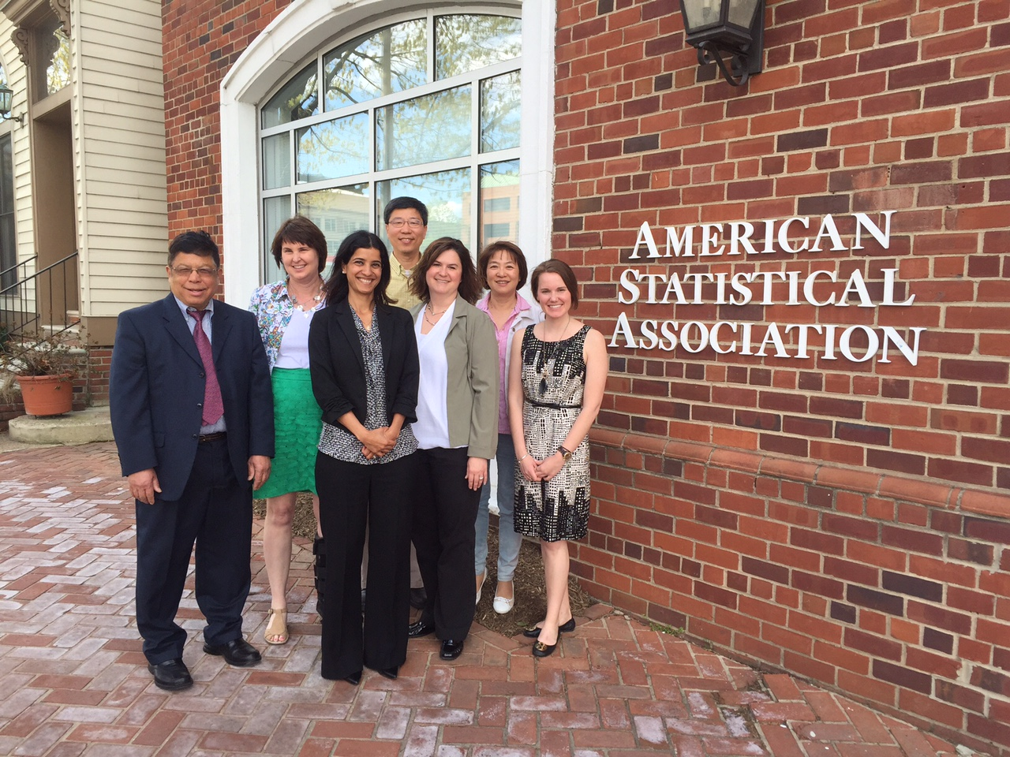
CMRR Members Include
Pictured: John Aleong, Sharon Murray, Rakhi Kilaru, Steve Yao, Jennifer Gauvin, Nancy Wang, Lauren Kunz
Not pictured: Nancy Petersen, Erica Billig.

Slide 16
Ongoing CMRR Activities
Reaching out to each new ASA member via welcome letter.
    1800+ letters sent!
Networking with Sections to connect members with like interests.

Slide 17
Future CMRR Activities
Evaluating the needs of ASA members to ensure members are supported and receiving valuable benefits.
Creating a new ASA program Colleague to Colleague ... Stay tuned for details!

Slide 18
JSM

